Slide 1


SOFTWARE Architecture
An Introduction to Software Architecture
Catalogue Number

Slide 2

Objectives
What we will learn today:
Recap of Software Design Principles and Patterns
Understand what is a Software Architecture
Why Architecture? And it’s importance
Levels of Architecture

Slide 3
Recap – Software Design Principles and Patterns
Design Principles:
General guidelines and best practices that are used to create software that is maintainable, scalable, and efficient.
Design Patterns:
Proven, generalized solution to commonly recurring software design problems. Guides to make design decisions more consistent and efficient.
SOLID
DRY
KISS
YAGNI
Creational
Structural
Behavioral

Slide 4
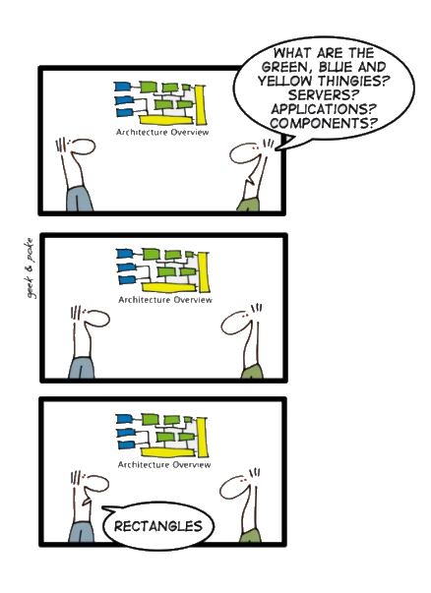
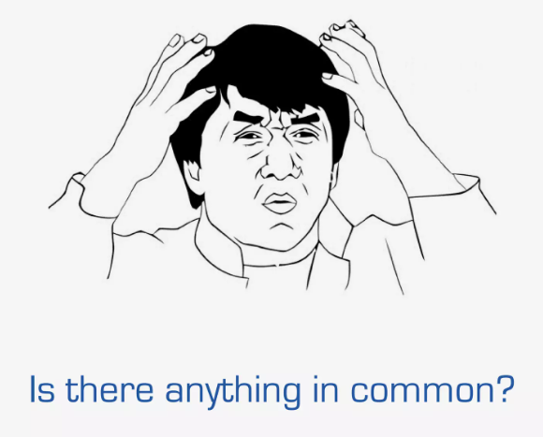
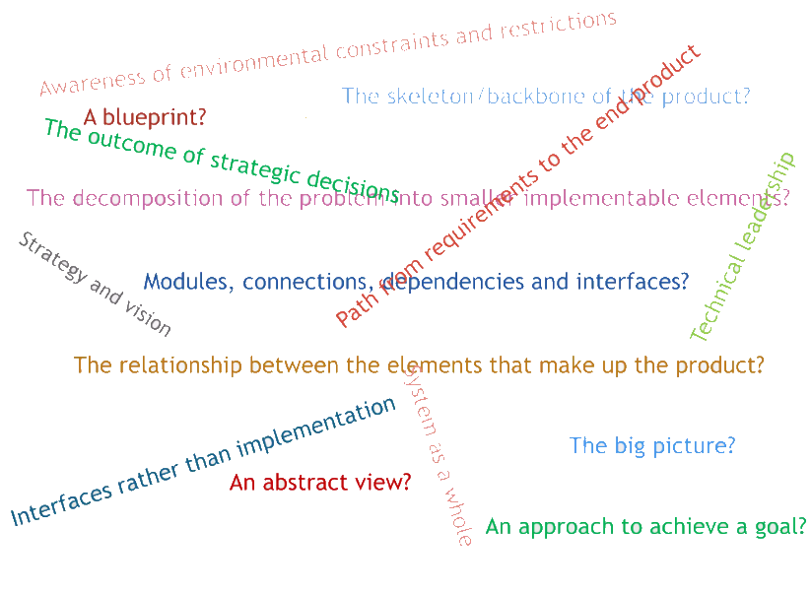
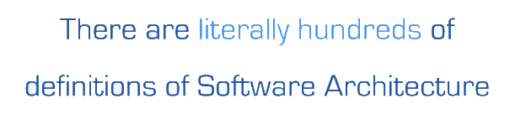
Introduction – Software Architecture
What is Software Architecture?

Slide 5
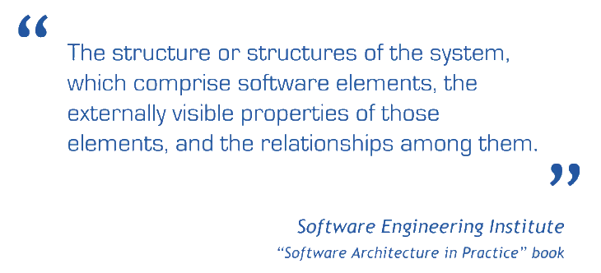
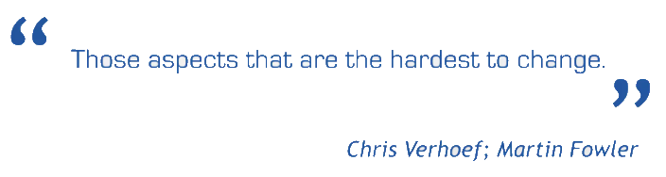
Software Architecture - Definition
Regardless of the Domain, the architecture work is about
STRUCTURE + VISION
Notes:
The software architecture of a program or computing system is the structure or structures of the system, which comprise the software components, the externally visible properties of those components, and the relationships among them. — Bass. et al.

Slide 6
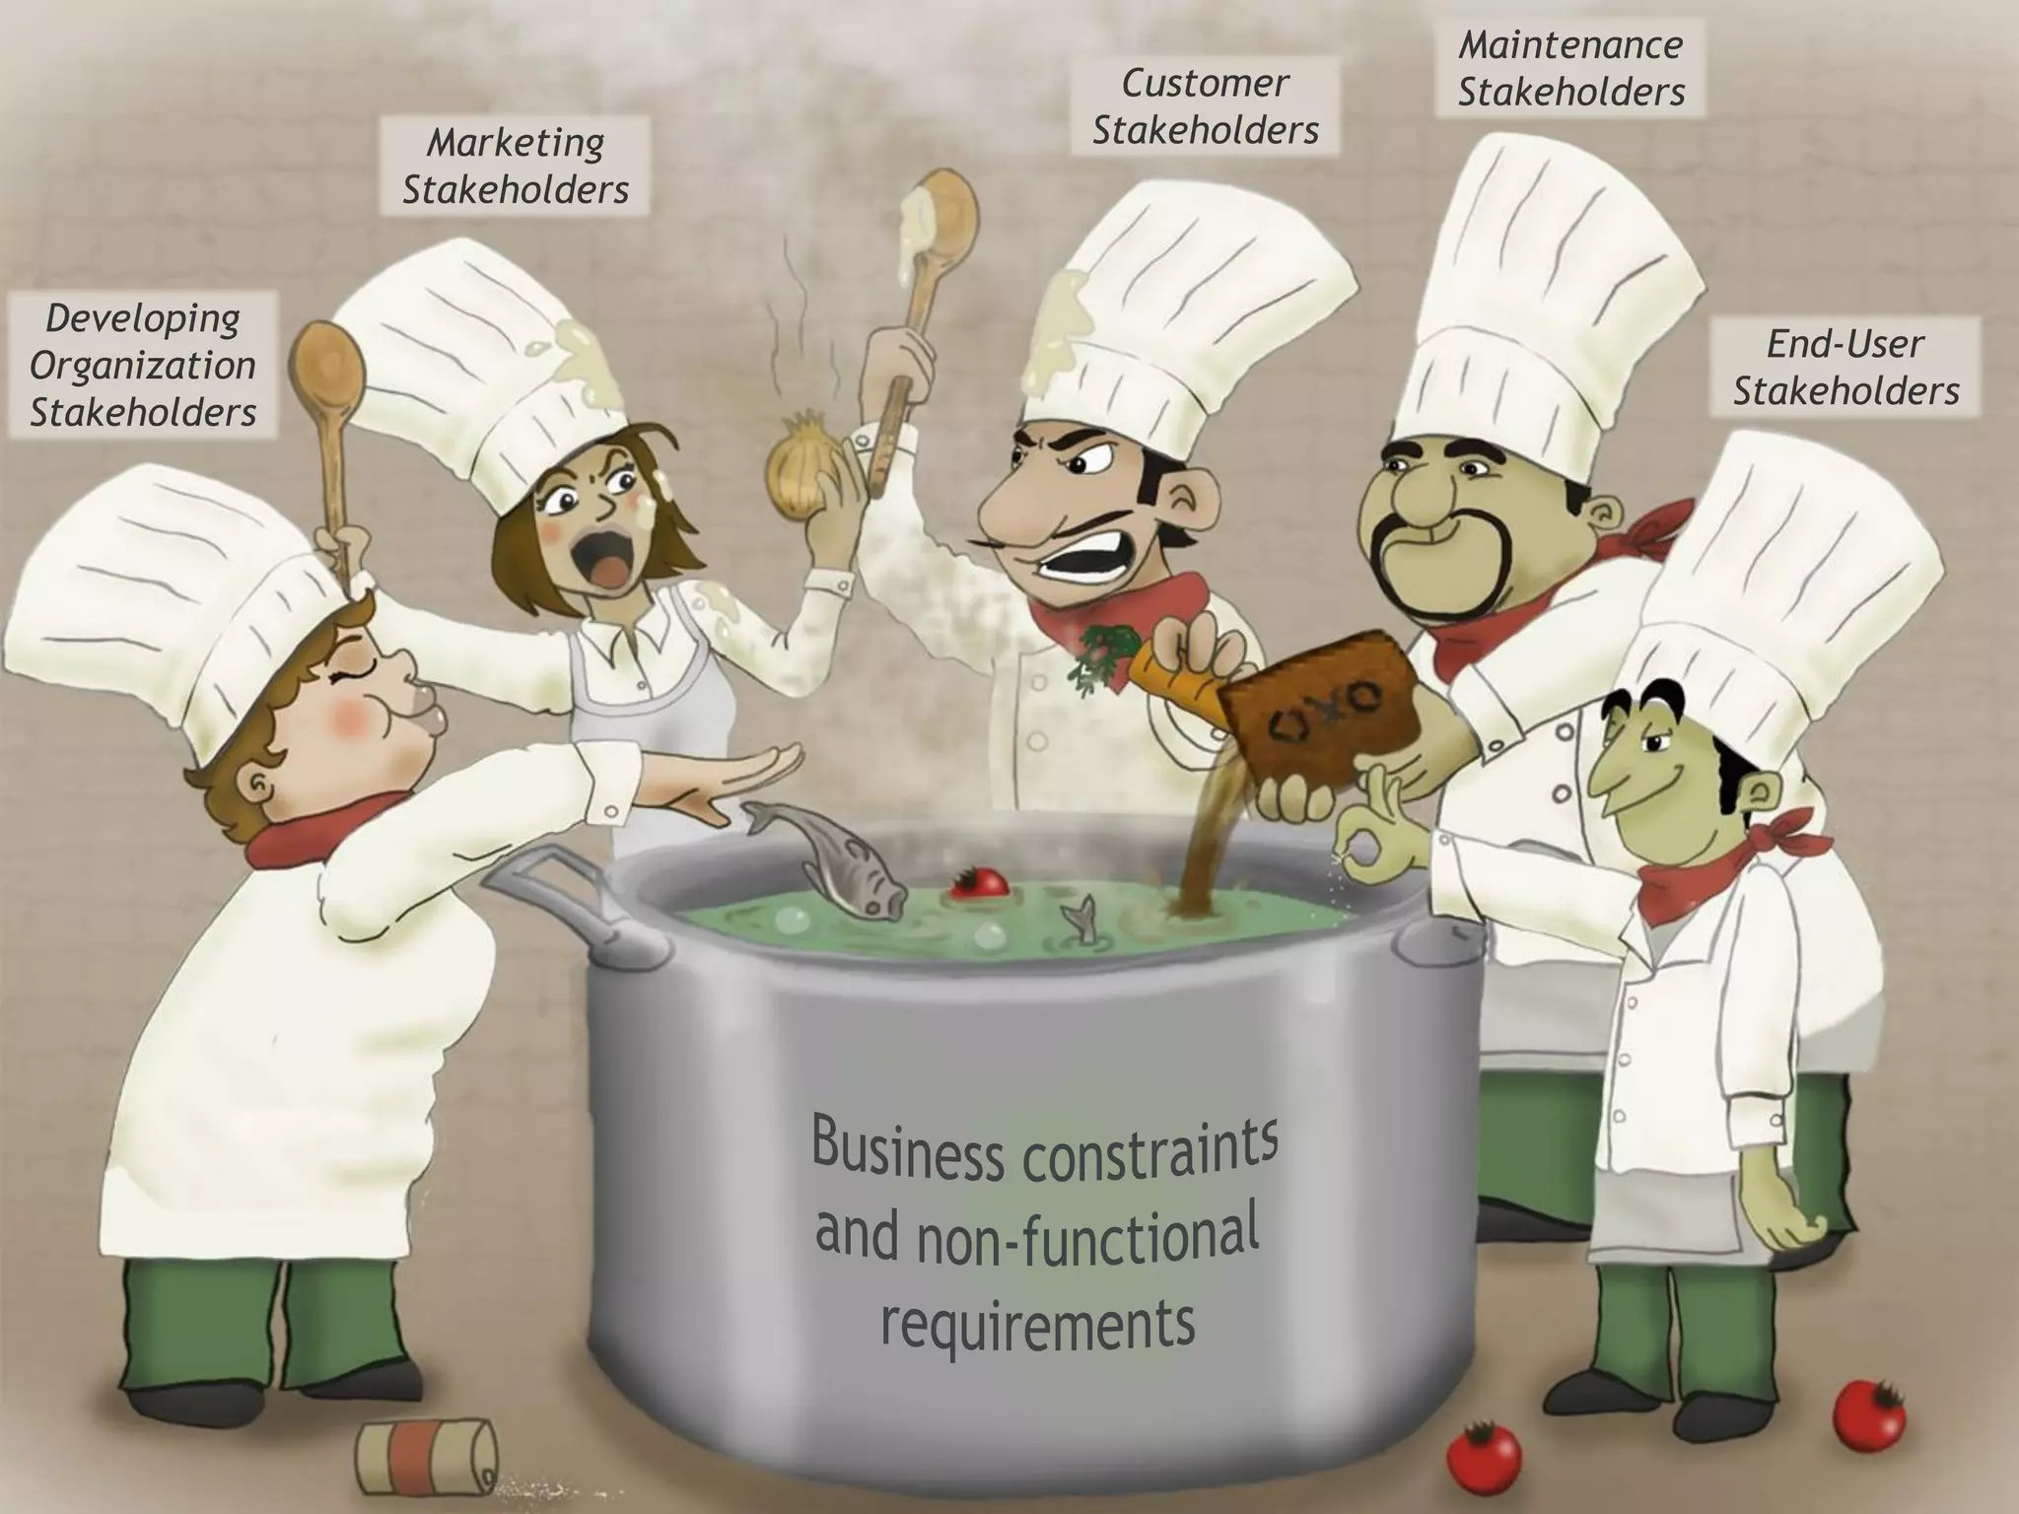
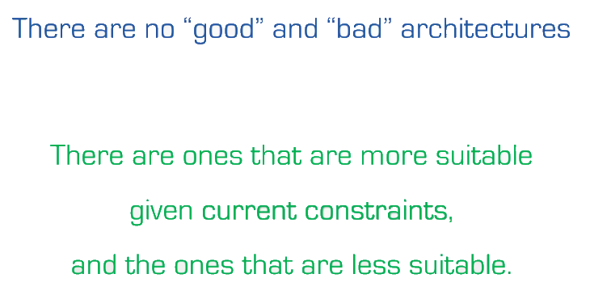
Software Architecture - Explained

Slide 7

Why Architecture?
The Architecture is not an Operational software. Rather, it is a representation the enables a software engineer to:
Analyze the effectiveness of the design in meeting the stated requirements.
Consider architecture alternatives at a stage when making design changes is still relatively easy, and
Reduce the risks associated with the construction of software.
Representations of software architecture are an enabler for communication between all parties (stakeholders) who are interested in development of computer based system.
The architecture highlights early design decisions that will have a profound impact on all software engineering work that follows and, as important, on the ultimate success of the system as an operational entity.
Architecture “constitutes a relatively small, intellectually graspable model of how the system is structured and how its components work together”.

Slide 8
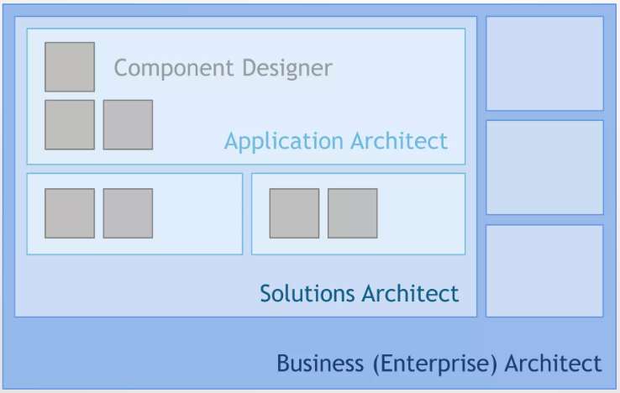
Levels of Architecture

Slide 9
Types of Software Architecture
Monolithic Architecture
Single, unified codebase.
Example: A traditional e-commerce application.
Layered (N-Tier) Architecture
Components organized into logical layers (e.g., presentation, business, data).
Example: Web applications with front-end, back-end, and database layers.
Microservices Architecture
Application divided into small, independent services.
Example: Netflix uses microservices to handle different features (billing, recommendations).
Event-Driven Architecture
Components communicate via events (asynchronous messaging).
Example: IoT applications that respond to sensor data in real time.
Serverless Architecture
Uses cloud services to run code only when needed, with no need to manage infrastructure.
Example: AWS Lambda, Azure Functions.

Slide 10
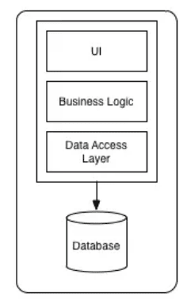
Monolith Architecture
single, unified codebase where all components of an application (UI, business logic, and database) are tightly coupled and run as one unit.
Key Features
Single Deployment: All components are packaged and deployed together.
Shared Memory: Modules can communicate directly without network protocols.
Tightly Coupled: Changes in one part often require redeploying the entire application.
Advantages
Simple Development & Deployment: Easier to get started.
Performance: Less overhead compared to distributed architectures.
Centralized Management: Single application to monitor and maintain.
Disadvantages
Hard to Scale: Entire application needs scaling, even for minor components.
Difficult Maintenance: Small changes require full redeployment.
Tight Coupling: Hard to adopt new technologies.
Use Cases
Small Applications: Startups or MVPs where simplicity matters.
Legacy Systems: Older systems still using monolithic design (e.g., early versions of WordPress).

Slide 11
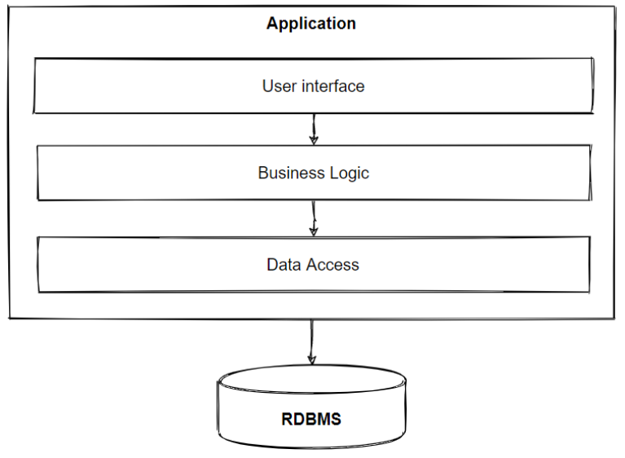
Layered (N-Tier) Architecture
Divides the application into logical layers, with each layer responsible for a specific concern, such as presentation, business logic, and data access. These layers interact in a sequential manner.
Common Layers
Presentation Layer: User Interface (UI) for interacting with the system (e.g., web or mobile app).
Business Logic Layer: Contains business rules and application logic (e.g., order processing logic).
Data Access Layer: Handles communication with the database or external data sources.
Database Layer: Stores and retrieves application data.
Advantages
Separation of Concerns: Each layer handles specific tasks, improving modularity.
Easier Maintenance: Changes in one layer don’t affect others.
Scalability: Layers can be scaled independently.
Disadvantages
Performance Overhead: Multiple layers introduce latency.
Tight Dependency: Changes across multiple layers may complicate updates.
Use Cases
Web Applications: Applications like e-commerce sites or ERP systems that involve user interfaces, business logic, and database interaction.

Slide 12
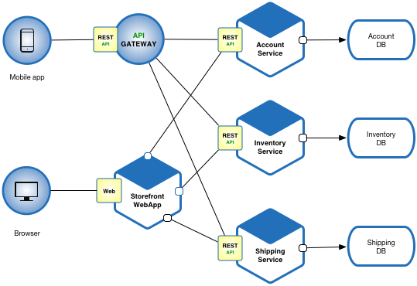
Microservices Architecture
Breaks an application into a collection of small, independent services that communicate over APIs. Each service is loosely coupled and focuses on a specific business capability.
Key Features
Independence: Each microservice is developed, deployed, and scaled independently.
Decentralized Data Management: Each service can have its own database.
Technology Diversity: Different services can use different technologies and languages.
Advantages
Scalability: Services can be scaled independently based on demand.
Fault Isolation: A failure in one service doesn’t bring down the entire application.
Faster Deployment: Teams can deploy services without waiting for the entire system.
Disadvantages
Complexity: Managing many services can be challenging.
Inter-Service Communication Overhead: Network latency can affect performance.
DevOps Required: Requires automation for deployment, monitoring, and scaling.
Use Cases
E-commerce platforms: Separate services for product catalog, orders, and payments.
Streaming services: Netflix uses microservices for content delivery and recommendations.

Slide 13
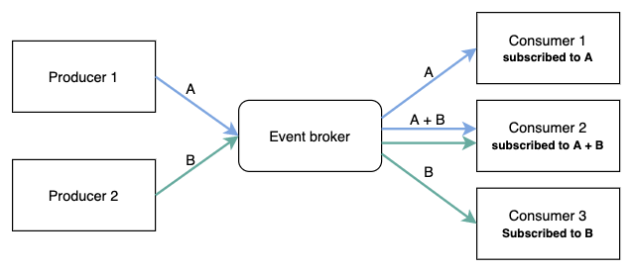
Event driven Architecture
Revolves around the detection and reaction to events. Components produce events (publishers), and other components (subscribers) respond to those events asynchronously.
Key Features
Decoupled Communication: Components interact via events without knowing about each other directly.
Asynchronous Processing: Events are processed independently, improving responsiveness.
Real-Time Responses: Triggers actions immediately when an event occurs.
Advantages
Scalability: Independent components make it easier to scale.
Flexibility: New event handlers can be added without disrupting the system.
Fault Tolerance: Partial system failures don’t impact the entire application.
Use Cases
IoT Systems: Sensors send real-time data for processing (e.g., smart homes).
Payment Systems: Payment confirmation triggers email notifications or updates to orders.
Streaming Platforms: User activity (like play or pause) generates events for recommendations.
Disadvantages
Complexity: Requires careful management of event flows and dependencies.
Testing Challenges: Harder to track issues across multiple event triggers.
Event Ordering Issues: Ensuring correct event sequence can be tricky.

Slide 14
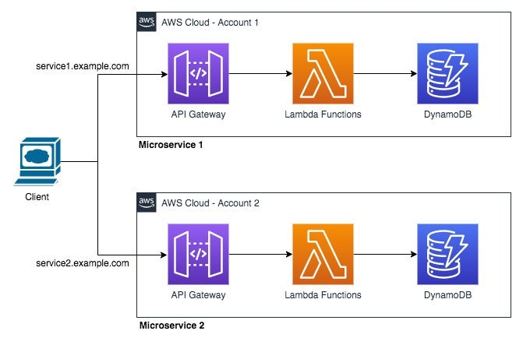
Serverless Architecture
Allows developers to focus on writing code without managing infrastructure. Applications run in cloud functions, which are executed only when triggered by specific events, and auto-scale as needed.
Key Features
No Server Management: Infrastructure is managed by the cloud provider (e.g., AWS, Azure).
Pay-as-You-Go: You only pay for the time your code runs.
Event-Triggered Execution: Functions are invoked in response to events, such as HTTP requests or database changes.
Advantages
Reduced Operational Costs: No need to manage or maintain servers.
Scalability: Functions automatically scale with demand.
Faster Time-to-Market: Developers focus on code, not infrastructure.
Use Cases
Webhooks and Notifications: Send notifications in response to user activities.
File Processing: Automatically resize or process images when uploaded.
IoT Systems: Handle real-time data from sensors with minimal infrastructure.
Disadvantages
Cold Start Latency: Functions may take time to spin up on first invocation.
Limited Execution Time: Some cloud functions have timeout restrictions (e.g., 15 minutes).
Vendor Lock-In: Tightly coupled with cloud provider technologies.

Slide 15
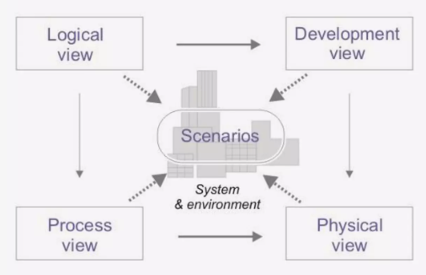
Architecture Visualization (4+1 Model)
The 4+1 View Model, introduced by Philippe Kruchten, organizes a software architecture into five views, each representing a different perspective. It helps stakeholders understand and validate the architecture by focusing on different concerns.
Logical View:
Purpose: Focuses on the functional requirements (what the system does).
Audience: Developers and designers.
Example: Class diagrams, object models.
Tools: UML diagrams.
Development View:
Purpose: Describes the software's structure from the developer’s perspective, including components and modules
Audience: Developers and system architects.
Example: Code modules, packages.
Tools: Component diagrams.
Use Case View:
Purpose: Captures the scenarios and use cases that show how the system interacts with users.
Audience: Business analysts, customers, and testers.
Example: Use case diagrams and stories.
Tools: UML Use Case diagrams.
Process View:
Purpose: Focuses on runtime behavior, including how components interact and communicate.
Audience: Performance engineers and system integrators.
Example: Activity diagrams, sequence diagrams.
Tools: UML Sequence diagrams.
Physical View:
Purpose: Shows the physical deployment of the software on hardware infrastructure.
Audience: System administrators and network engineers.
Example: Server nodes, network architecture.
Tools: Deployment diagrams.

Slide 16
Architecture Visualization (4+1 Model) Cont’d…
Visualization Example:
Imagine building an e-commerce platform:
Logical View: Product, Order, and Payment classes.
Development View: Frontend, backend modules.
Process View: Checkout process with API calls between modules.
Physical View: Cloud deployment on multiple servers.
Use Case View: Customer placing an order
This 4+1 View Model provides a structured way to document and communicate complex architectures efficiently.
Visualization Advantages:
Comprehensive Understanding: Covers both technical and business perspectives.
Different Stakeholders Focus: Tailors to developers, analysts, and operations.
Facilitates Communication: Improves collaboration between diverse teams.

Slide 17
Key Architectural Considerations
Scalability:
Can the system grow with user demand?
Maintainability:
Can developers easily update or fix issues?
Performance:
How fast does the system respond to requests?
Cost:
Does the architecture align with budget constraints?
Security:
Are data and services protected?

Slide 18
How to choose the Right Architecture
Project Requirements: Consider complexity, budget, and deadlines.
Team Skillset: Choose an architecture your team can manage.
Scalability Needs: Plan for future growth if necessary.
Technology Stack: Match architecture with your stack (e.g., use microservices for cloud-native apps).
Deployment Strategy: Decide whether on-premises, cloud, or hybrid deployment is needed.

Slide 19
Conclusion
A well-designed architecture is crucial for the success and longevity of software projects.
Familiarity with patterns and architectural types equips you to handle real-world development challenges confidently.
As you grow in your career, understanding how and when to apply architectural patterns will be key to delivering robust solutions.

Slide 20
Exercise
Monolithic: Build a simple blog website.
Microservices: Design an e-commerce platform with cart, product, and payment services.
Layered: Create a university management system with student, course, and grading layers.
Event-Driven: Design a food delivery system where orders trigger real-time updates to restaurants.
Serverless: Build a photo-sharing app where image uploads trigger resizing functions.

Slide 21

Questions

Slide 22


